Slide 1
Data wrangling is the process of transforming and mapping data from one "raw" data form into another format. [wikipedia]
Raw data:
Afghanistan is located within South Asia and Central Asia which has life expectancy of 28.801 years in 1952………

Slide 2
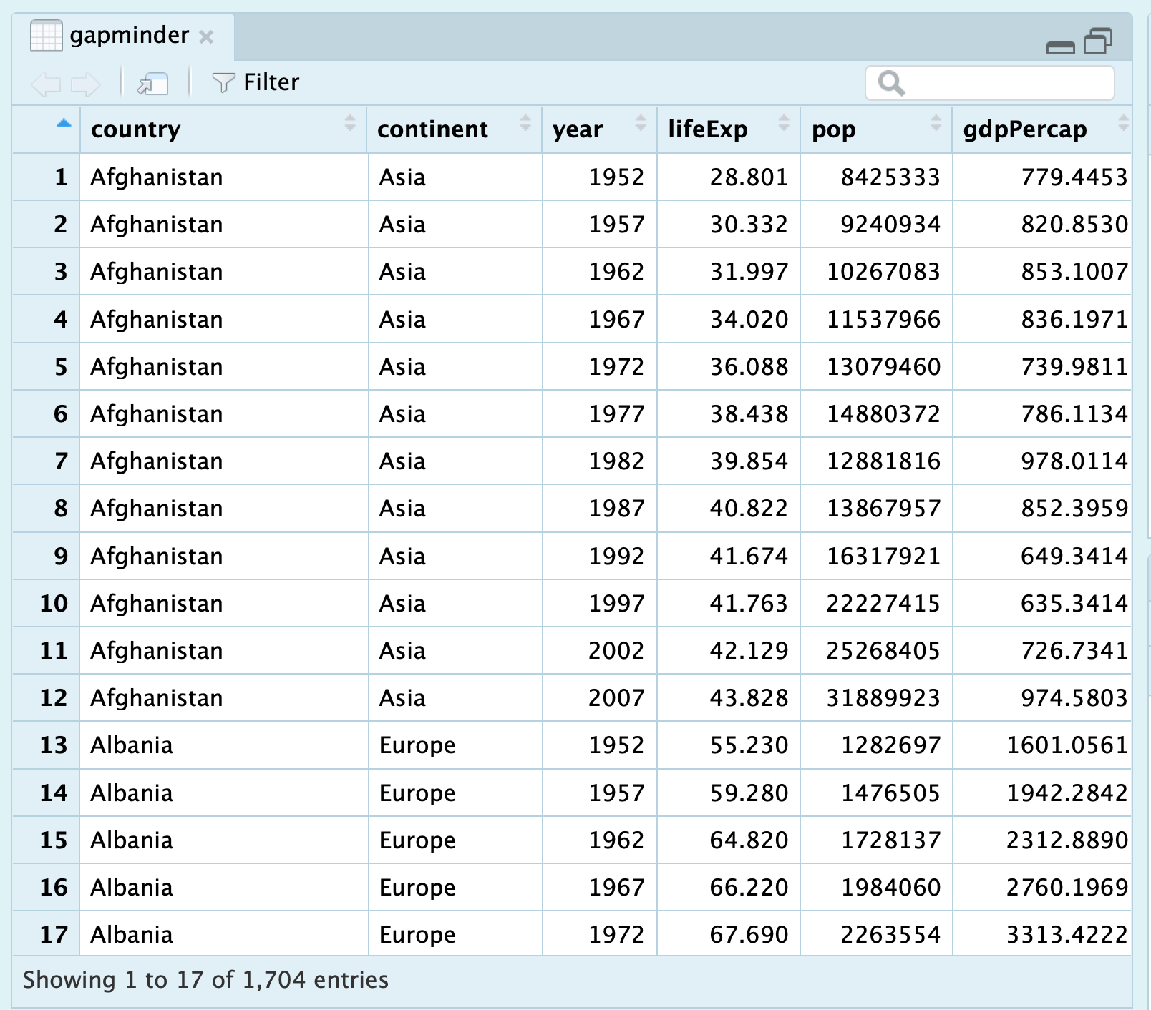
Data wrangling is the process of transforming and mapping data from one "raw" data form into another format. [wikipedia]
Raw data:
Afghanistan is located within South Asia and Central Asia which has with life expectancy of 28.801 years in 1052………

Slide 3
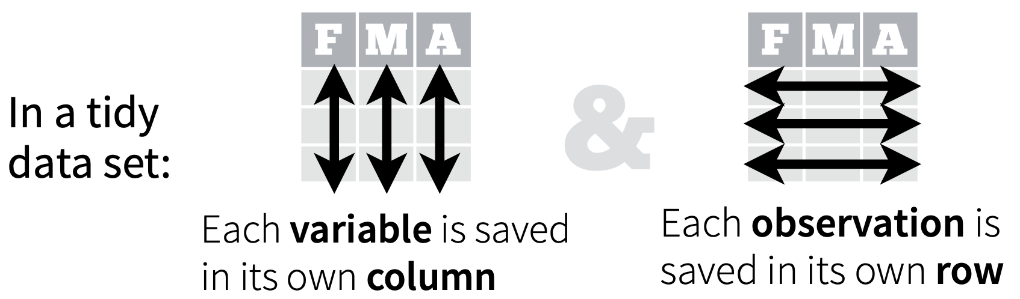
Tidy data sets are arranged such that each variable is a column and each observation (or case) is a row. [wikipedia]

Slide 4
Data wrangling and tidy data

Slide 5
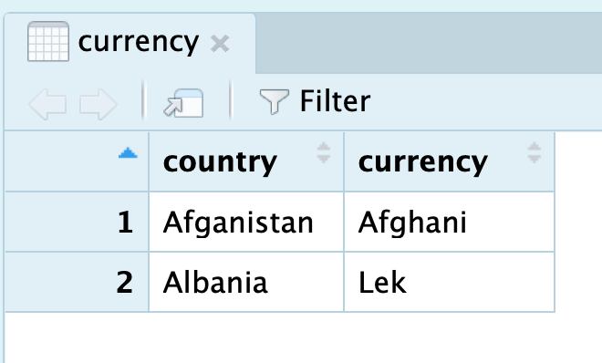
Data wrangling examples

Slide 6
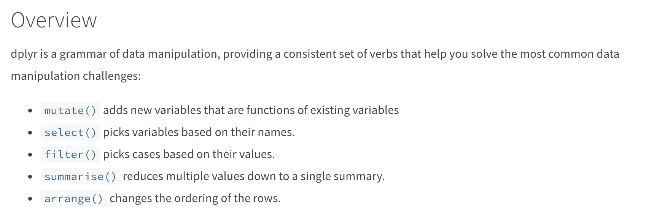
Introduction to dplyr

Slide 7
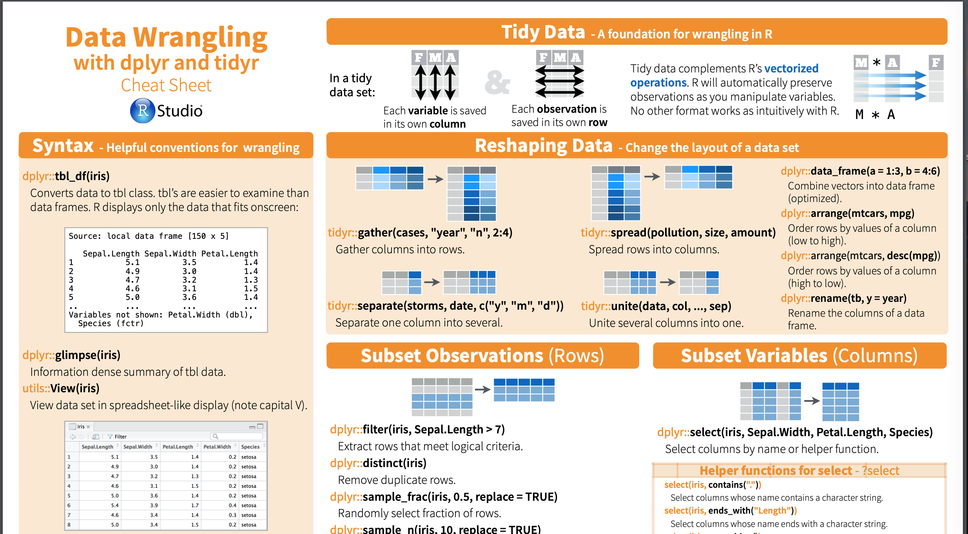
Introduction to dplyr
https://www.rstudio.com/wp-content/uploads/2015/02/data-wrangling-cheatsheet.pdf

Slide 12
Data structure
In computer science, a data structure is a data organization, management and storage format that enables efficient access and modification. [wikipedia]

Slide 13
Data structure in R
Two dimensional data: dataframe, matrix etc.
One dimensional data: vector, list, factor etc.

Slide 14
Basic functions in R
- The package named base contains the basic functions of the language
- No need for separate installation
- For reading and manipulating data

Slide 15
R packages
- Packages are units of reproducible R code
- They include:
- reusable R functions
- the documentation
- sample data
- others can easily download and use.

Slide 16
Data structure 01
Package 01
Data structure 02
Package 02

Slide 17
Data structure 01
Package 01
Data structure 02
Package 02

Slide 18
Pipe operator in R

Slide 19
Pipe operator in R
sum(3,2) → output_01

Slide 20
Pipe operator in R
sum(3,2) → output_01
mean(output_01) → output_02

Slide 21
Pipe operator in R
sum(3,2) → output_01
mean(output_01) → output_02
log(output_02) → final_output

Slide 22
Pipe operator in R
sum(3,2) → output_01
mean(output_01) → output_02
log(output_02) → final_output
sum(3,2) %>% mean() %>% log()
pipe

Slide 23
Pipe operator in R
sum(3,2) → output_01
mean(output_01) → output_02
log(output_02) → final_output
sum(3,2) %>% mean() %>% log()

Slide 24
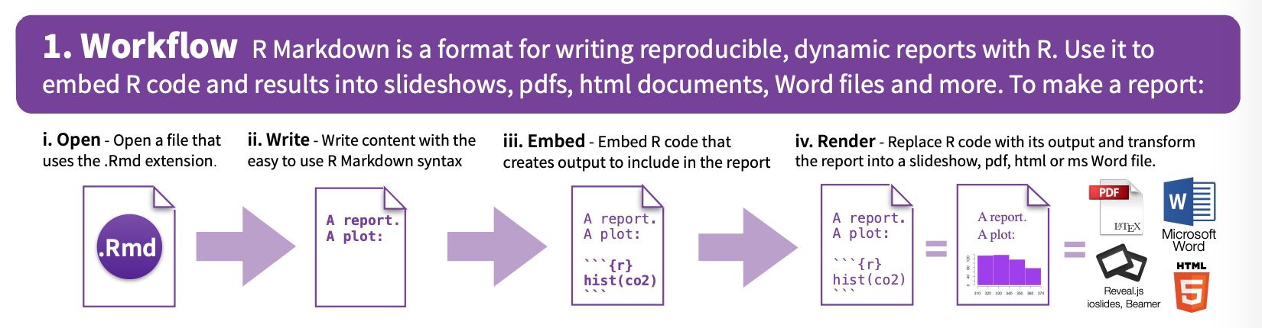
R Markdown
Source: R Markdown cheatsheet

Slide 25
DATA VISUALIZATION IN R - has strong graphic capabilities - you can create and save graphs in R - R is flexible and easy to use for visualisations
"A picture is worth a thousand words"

